Slide 1


Doubling the size of Inwido, profitably, by year 2030
Handelsbanken Nordic Small & Mid Cap Seminar
Peter Welin, CFO & Deputy CEO
Stockholm, 4 June 2026

Slide 2

We’re on an exciting journey towards SEK 20 billion in turnover by year 2030
A leader within Europe’s fundamentally attractive window and door industry
Weathering historic downturn well while also strengthening strategic position
Strategic acquisitions ahead of anticipated cycle rebound and green transition
Notes:
We also want everyone in the Inwido family to adhere to our Code of Conduct and embrace our strong values in every contact with colleagues, customers, suppliers and other stakeholders. A couple of perspectives guide us in particular:

Slide 3
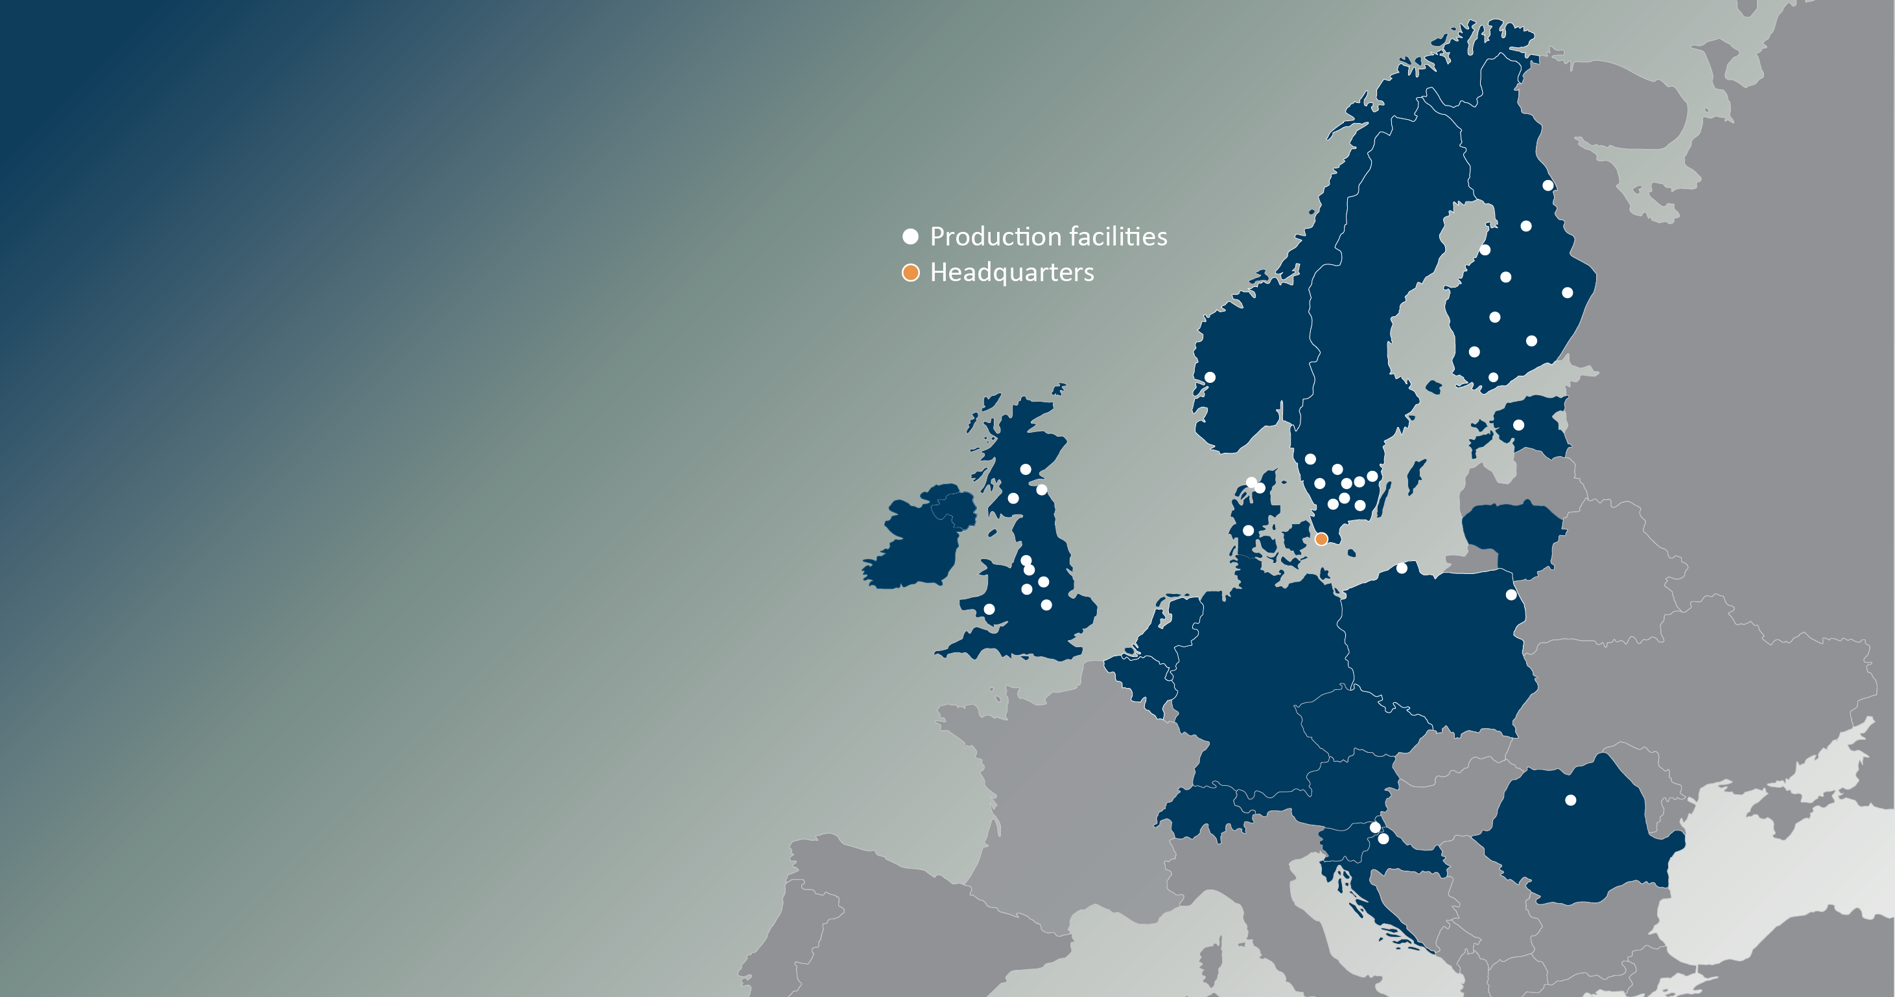
3
Europe’s leading
window group
Inwido facts and figures (pro forma)
Established in 2004 – publicly listed since 2014
Sales SEK 10 billion – Op. EBITA margin 10.5%
No. 1 in the Nordics – No. 2 in the UK
Improving quality of life – strong brands
Truly decentralized governance model
Proven stability over economic cycles
6 acquisitions in past 7 months – 2 new markets
37
5,000
19
business units
employees
countries
Slovenia and Croatia new markets

Slide 4
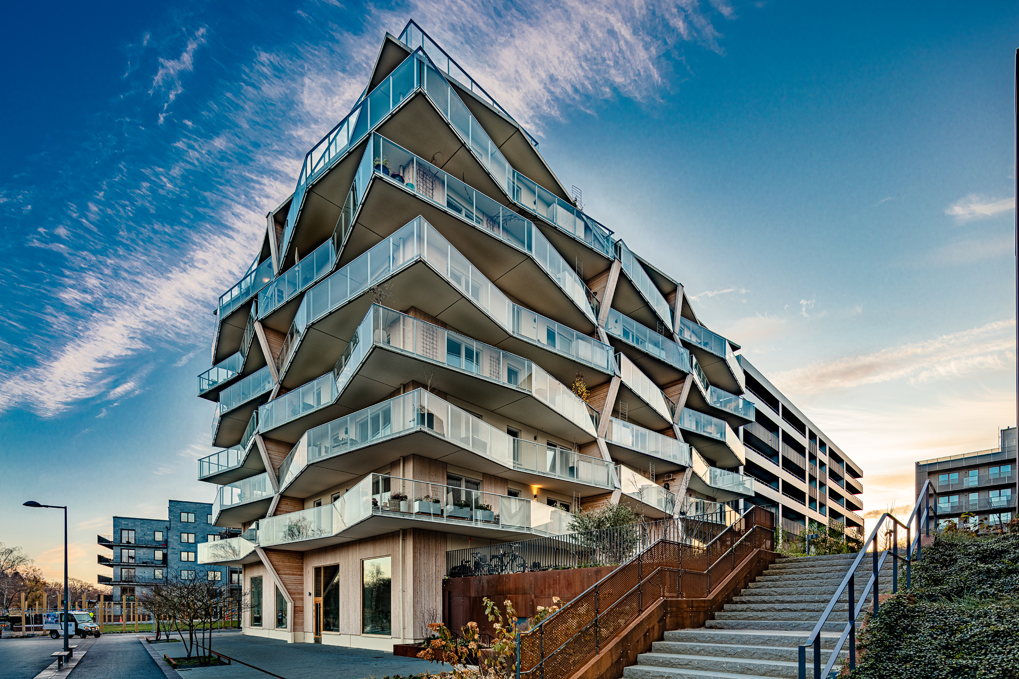
Impressive value creation since 2014 IPO
Sales +83%, Op. EBITA +88% and EPS +188% | A total of SEK 2.5 bn paid out in dividends
Net Sales, MSEK
Op. EBITA margin, %
Dividend, SEK/share
2.00
2.50
3.50
3.50
2.50
0.00
4.50
6.15
6.50
6.50
5.50
5.50

Slide 5
Executing our strategic roadmap well – ready for upturn!
Illustrative Net Sales development 2026-2030, SEK million | CAGR ~15% p.a., of which ~5 ppts. organic
M&A
Our own organic growth initiatives
EU’s Green Deal and EPBD
Pent-up demand in New-build
Normalized Renovation demand
Additional volume through a more efficient operational structure, e.g.
Value-based pricing
Intra-Group synergies
Return on investments
Portfolio management
2025
Market 2026
through 2030
2030
Notes:
MÅLET KAN TYCKAS AMBITIÖST – MEN FULLT GÖRBART ENLIGT MIG OCH GMT
BEHÖVER VÄXA MED CA 15% PER ÅR FR O M NU – 50 / 50 ORGANISKT VS M&A
FLERA CENTRALA BYGGSTENAR – SEDAN NY VOLYM I MER EFFEKTIV STRUKTUR

Slide 6








6 acquisitions over past
7 months, adding 1.5 BSEK
2 new markets entered – Slovenia and Croatia
RM Snickerier
Sweden
Marlex
Croatia
Fast Frame
UK
Sovereign
UK
AJM
Slovenia
Victorian Sliders
UK

Slide 7
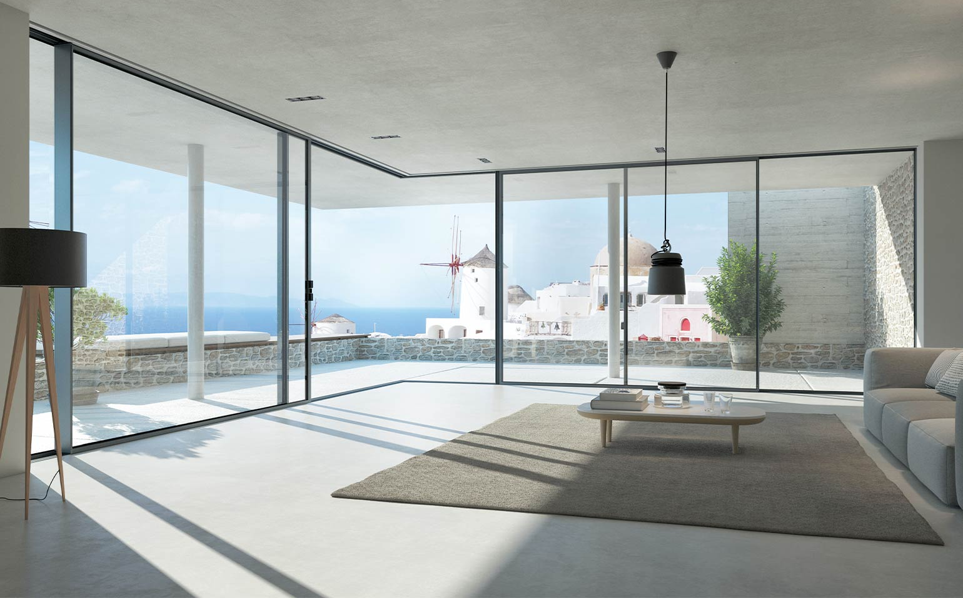

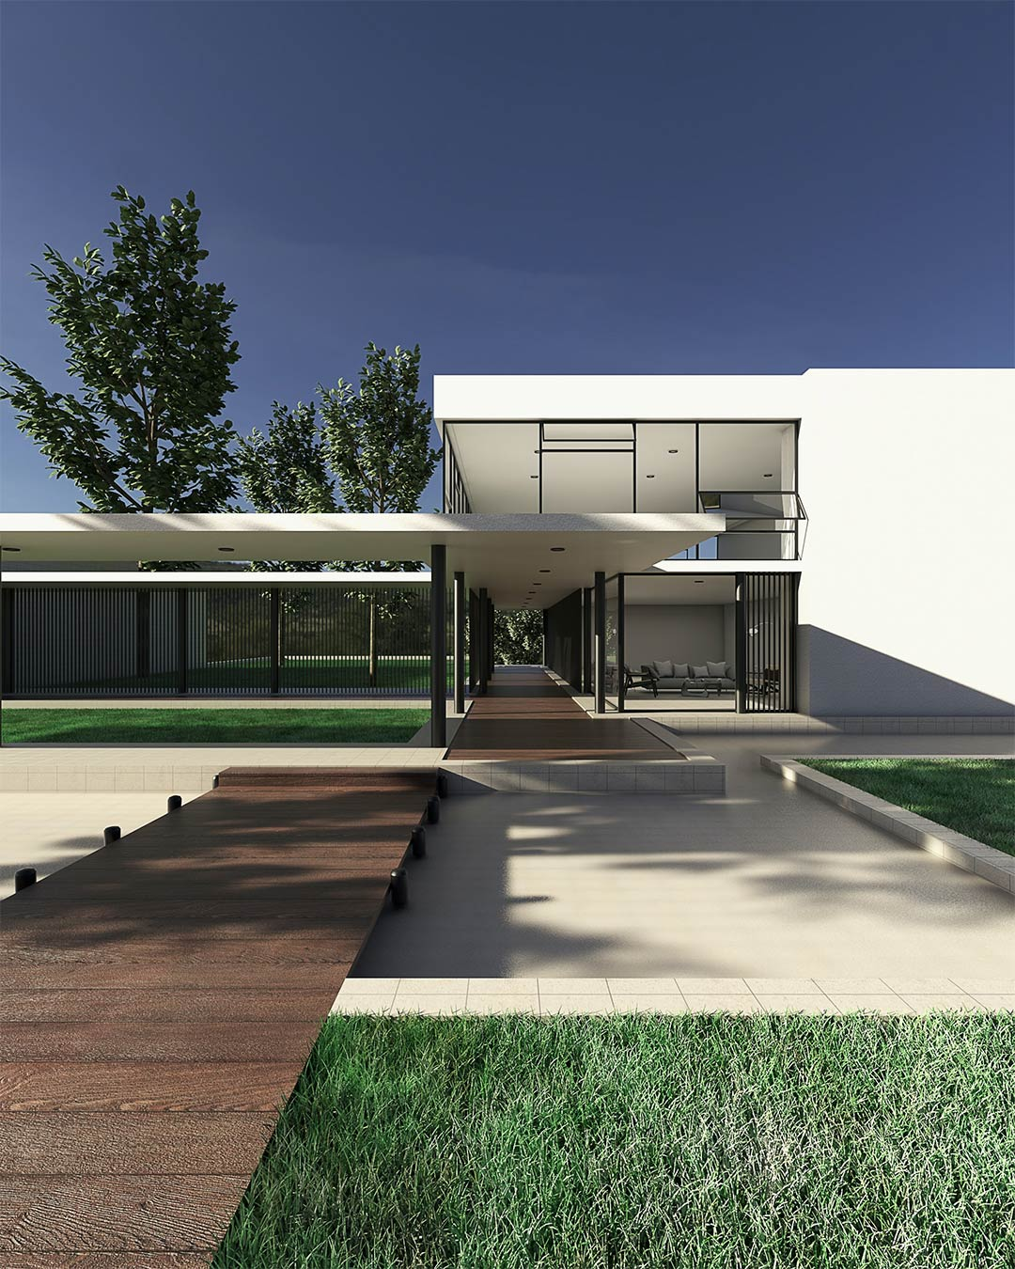
Acquiring the leader in yet another new market
Marlex d.o.o., Varaždin, Croatia
Inwido’s 6th acquisition in 7 months
Manufacturer of PVC and aluminum windows, doors, and insulating glass – No. 1 in Croatia in PVC
Founded in 2003 – sales 33 MEUR, 270 FTEs
Strong brand and distribution network (>50 partner stores)
Profitability above Inwido’s average
Promising synergy upside potential
  Sales, Operations, Purchasing
  Collaboration (capacity sharing) with AJM in Slovenia
Signed on 7 May, closing expected in June 2026
  Acquiring 70% of shares at 5.1x FY 2025 EBITDA
  Call / put option for remaining shares in 2028

Slide 8

Weathering historic downturn and strengthening position
Enjoying the performance track record, finances and people needed for long-term success
Volume drop -30% since 2022…
Organic sales decline -18%
Low consumer confidence overall
Finland at all-time-low
Negative segment mix
Fierce price pressure
SEK strengthening
Geopolitical uncertainty
…but profitability only marginally lower!
Proactively adjusting cost base
Pruning portfolio – 2 BUs restructured last 12 months
Gaining share from high OTIF – ‘flight to safety’
Confident pricing – profit before volume
Leveraging balance sheet and cash flow – capex and M&A
Horizontal synergy extraction – purchasing, operations
New product launches

Slide 9

A seasonally challenging quarter in a turbulent context
Highlights Q1 2026
Net sales
change
organic change
Order intake
organic change
Order backlog
change
Operating EBITA
Operating EBITA margin
Net debt vs Op EBITDA
Pro forma
SEK 2,083m (1,999)
+4%
-2%
+3%
-3%
SEK 2,639m (2,660)
-1%
SEK 90m (111)
4.3% (5.5)
1.9x (0.8)
1.7x
Always lower activity in the first quarter and more seasonality this year compared to recent years
Increased geopolitical uncertainty, volatile commodity markets and unusually harsh winter conditions
Large market variations – Denmark softer
March substantially better than January / February
Continued focus on cost alignment and pricing
BAs e-Commerce and West improving profitability
Gained market share, new products launched, and
award-winning environmental and employee engagement performance
Sovereign Group (UK) acquired on 2 April
Notes:
As mentioned little more than a month ago, we have every reason to be proud of Q1 performance – fighting historically low levels in new-build, and without destroying the business in the short or long term, is impressive.
A lot is about the lack of volume, but in a more seasonal environment, at the same time, Q1 is always the weakest.
There are definitely positives to highlight as well, especially the consumer side in Denmark and in e-Commerce, as well as Sidey's contribution.
What we stated in April still holds true: The second quarter has started positive, primarily on the consumer side, with Denmark leading the field but with activity picking up also in Sweden and in Finland – in the case of Sweden, the recent interest rate cut by Riksbanken was an important psychological trigger for the sector, plus rising property valuations and more deals done, and the weather has helped too.
England still remains soft, and 3 out of our 5 major competitors have gone belly up, of course creating opportunities for us.

Slide 10
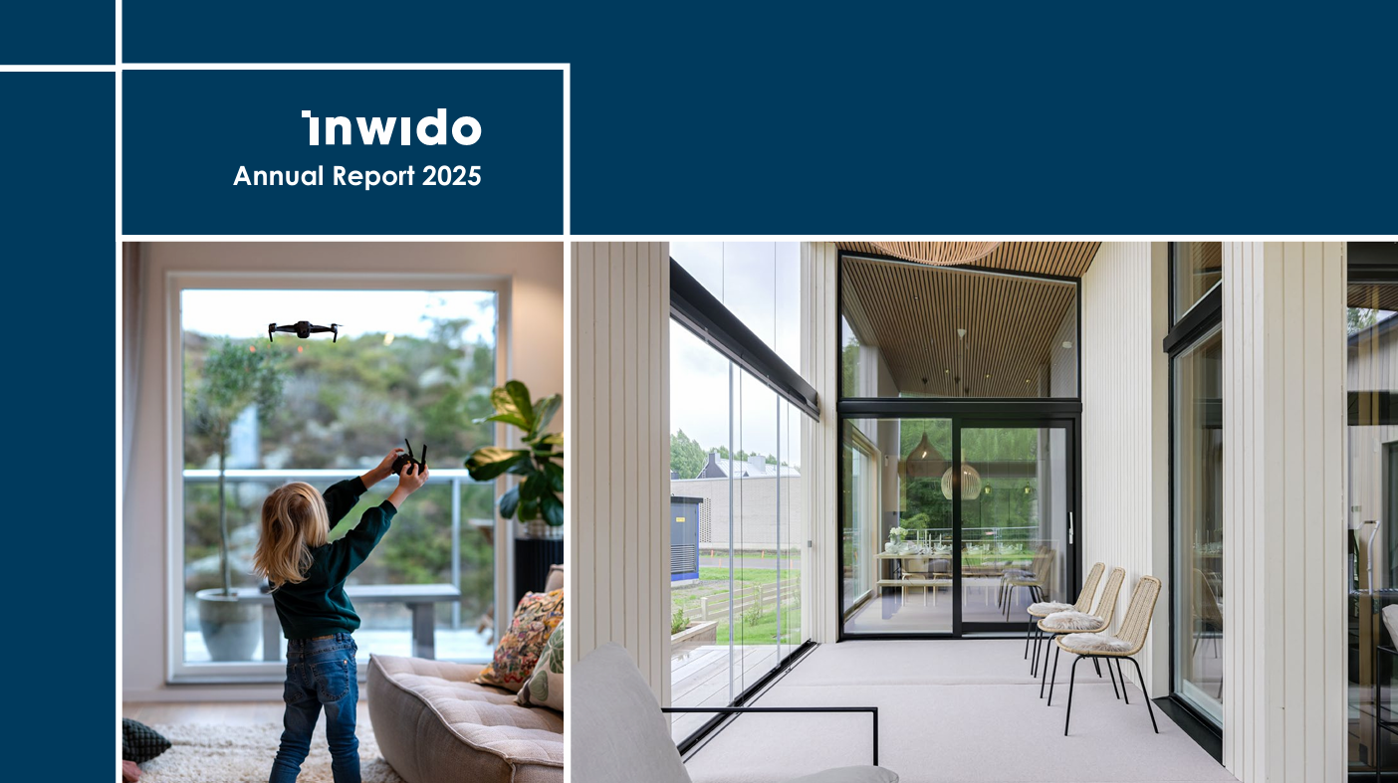
Upcoming events
Financial calendar 2026
Hot off the presses – our new annual report
July 15 Q2 report 2026
October 21 Q3 report 2026
December 9 Capital Markets Day, Stockholm
February 9, 2027 Q4 report 2026

Slide 11

Notes:
EN FÖRKLARANDE FAKTOR BAKOM VÅR FRAMGÅNG I LÅGKONJUNKTUREN
PUDELNS KÄRNA – GENUINT DECENTRALISERAT, SMÅLÄNDSKT
JAG HAR STUDERAT OCH UPPLEVT DEN NÅGRA OMGÅNGAR – FUNGERAR BRA
TVÅ PÅGÅENDE REKRYTERINGAR TILL KONCERNLEDNINGEN

